Slide 1
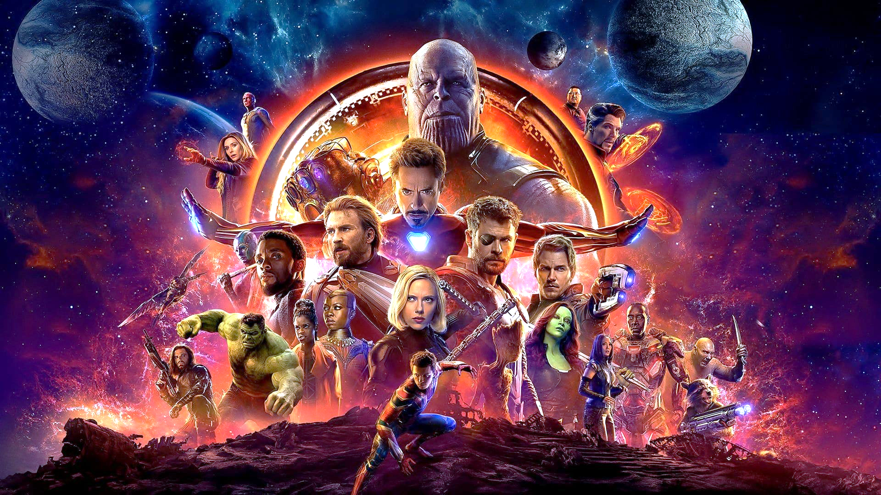
Avengers: Phase 3 quiz
Made by Jan James Lysnar 28/04/2019

Slide 2
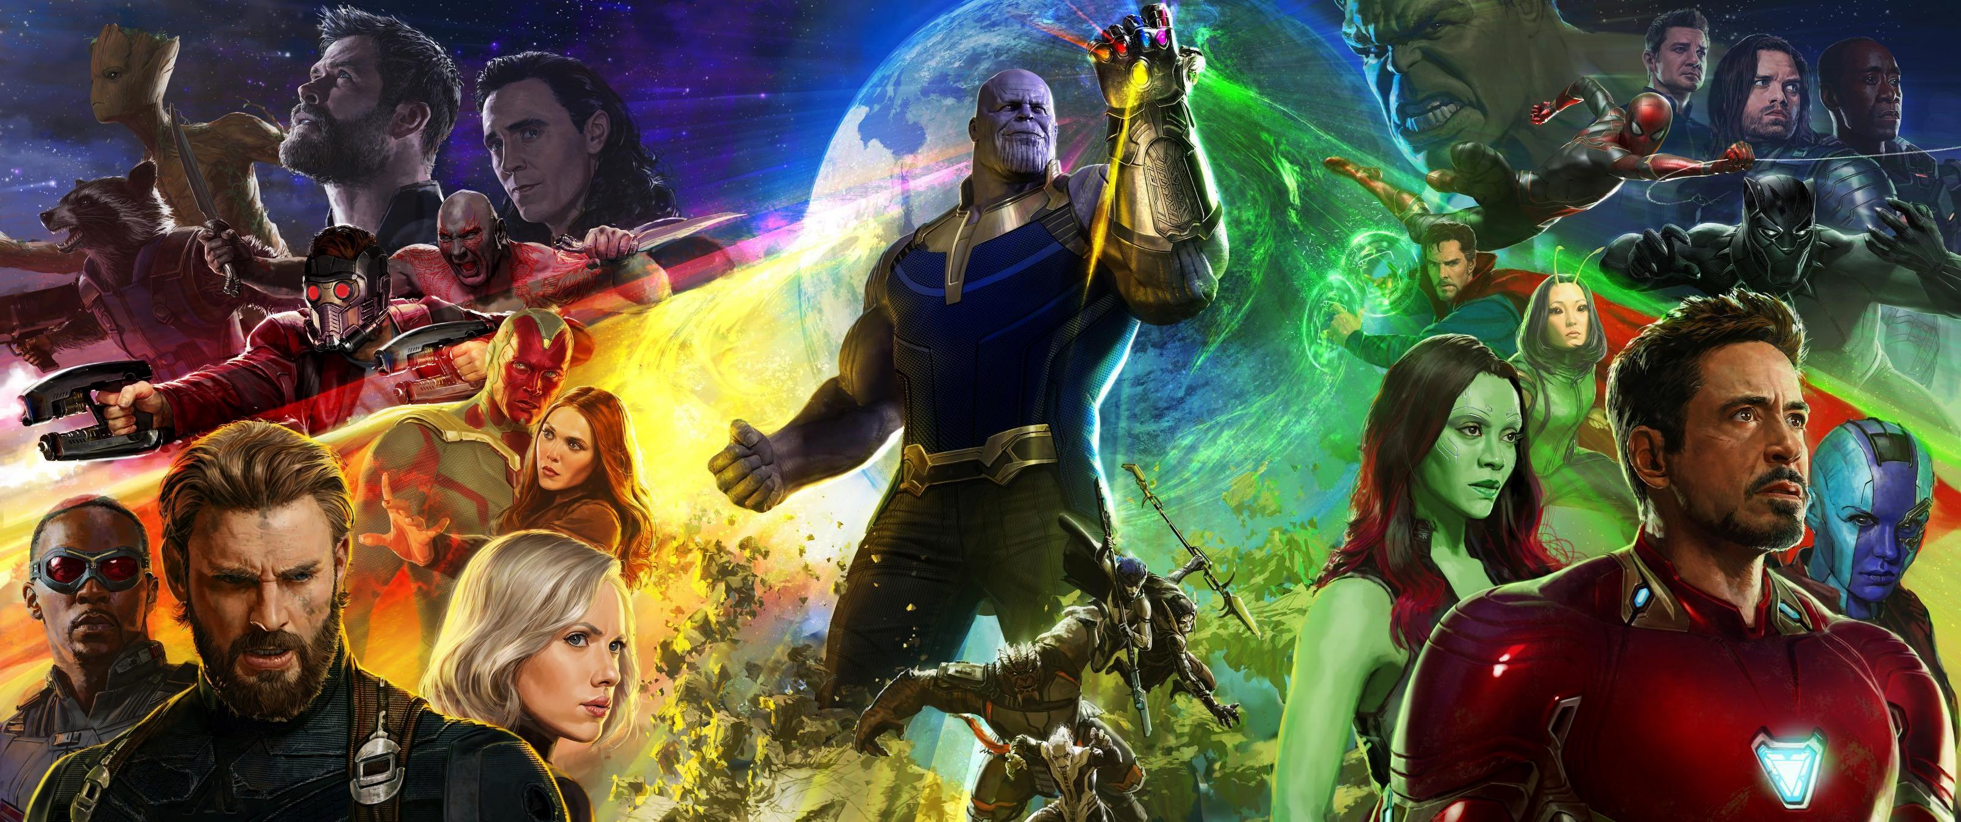

Welcome to the Quiz!
In this quiz you’ll be questioned from all the major story plot lines to the small little details in the movie! Do you have what it takes to complete all 50 questions correctly?

Slide 3

Question 1

Slide 4
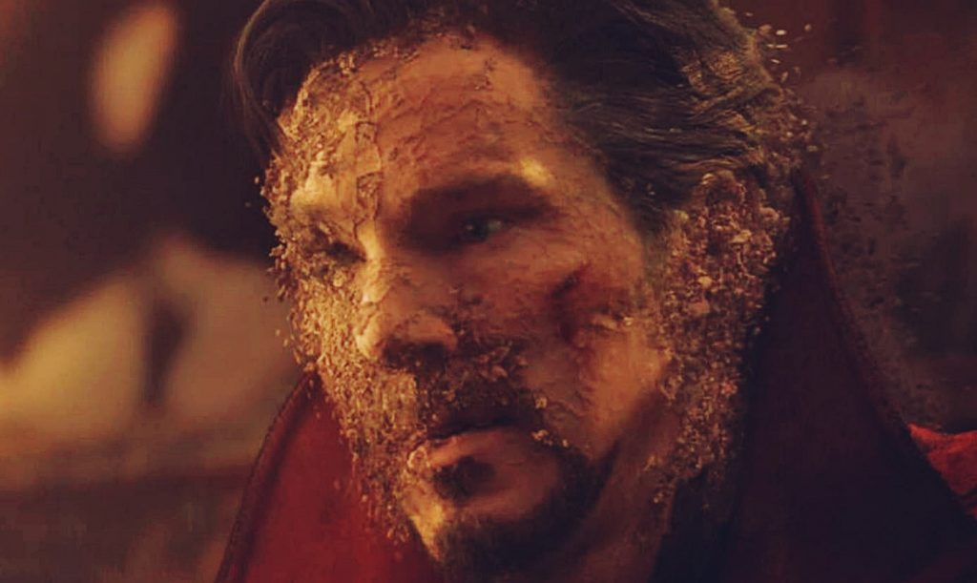

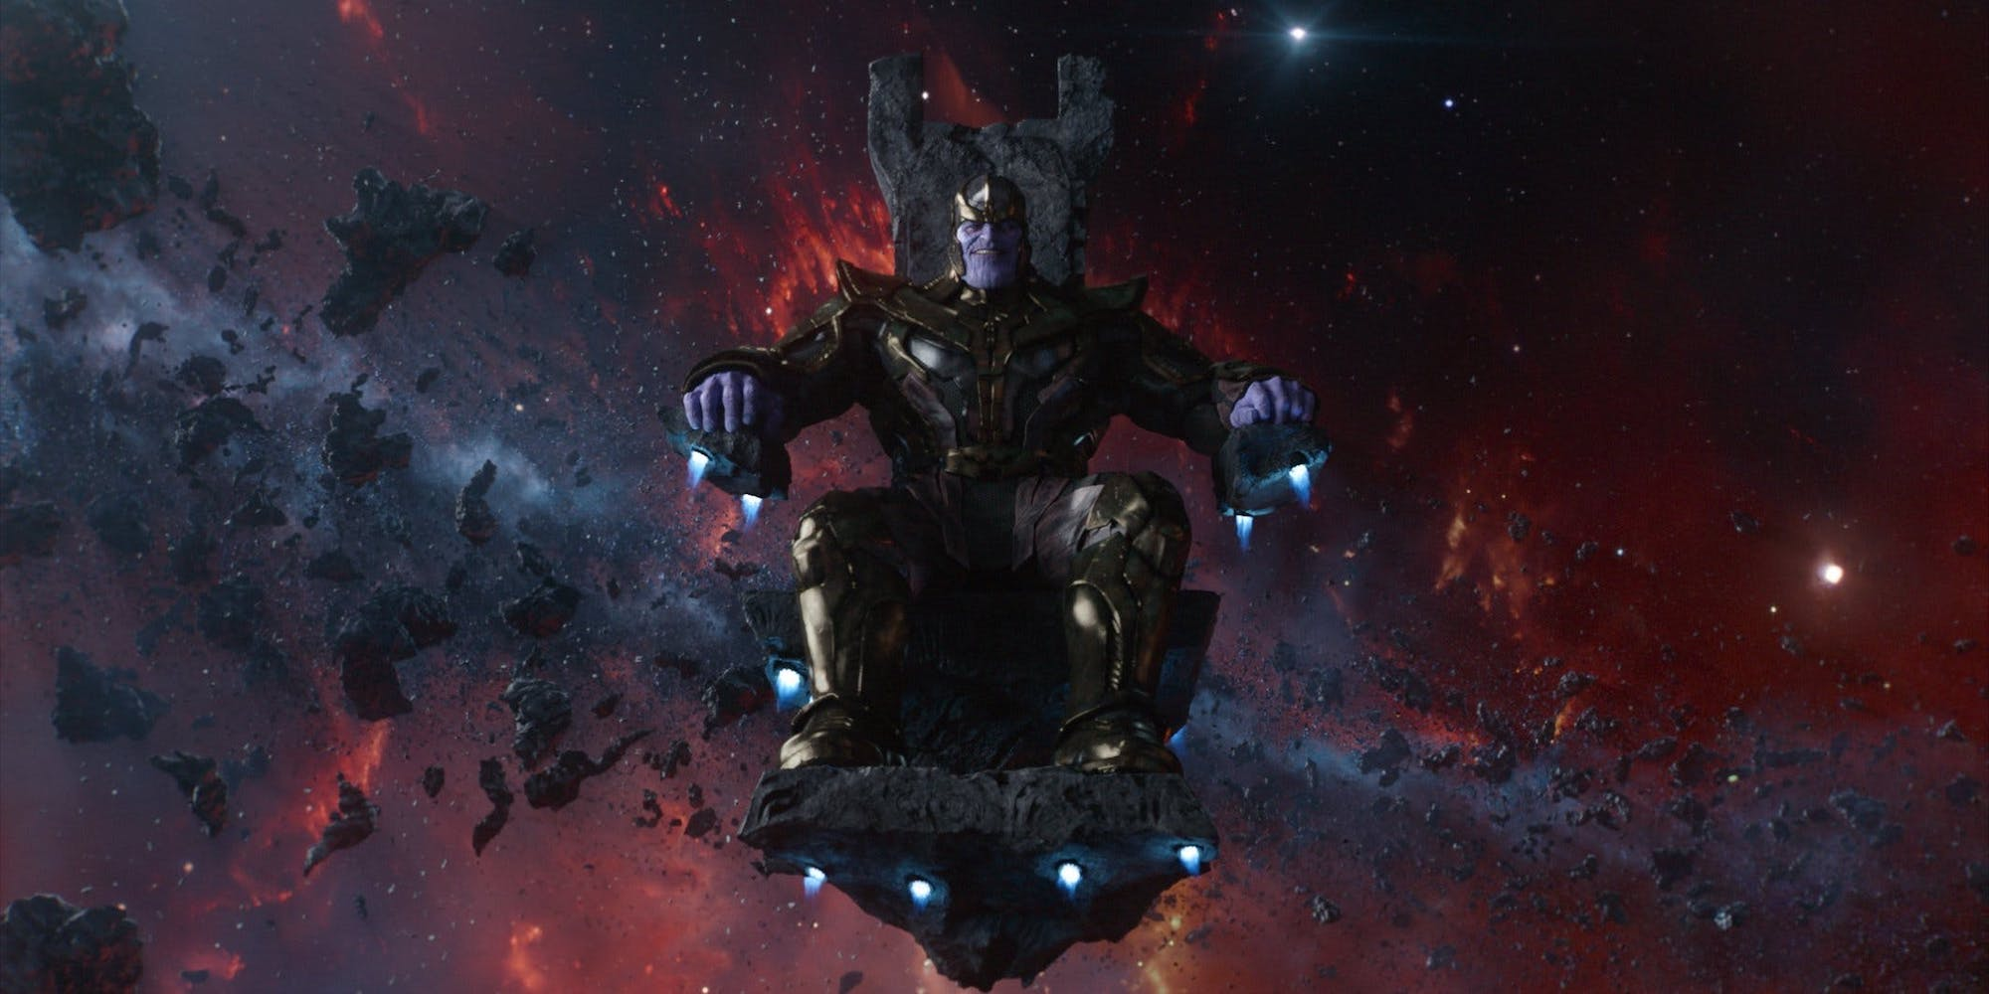
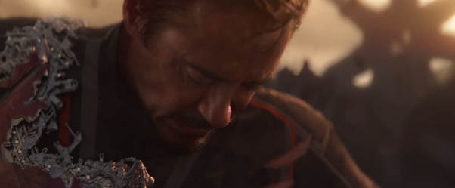

Question 1
What was Thanos’s end goal in Infinity war?
Remove 50% of the Universe
Create a new, better Universe
Become god of the Universe
Need Hints?
Kill all of the Avengers forever

Slide 5
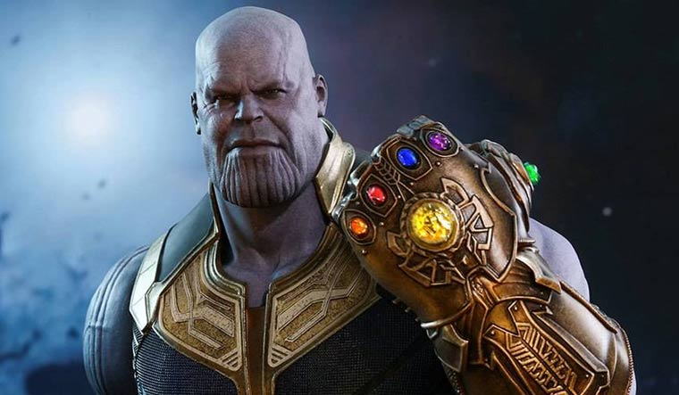
“When I’m done,
half of humanity will still exist.
Perfectly balanced,
as all things should be.”
You are CORRECT!

Slide 6
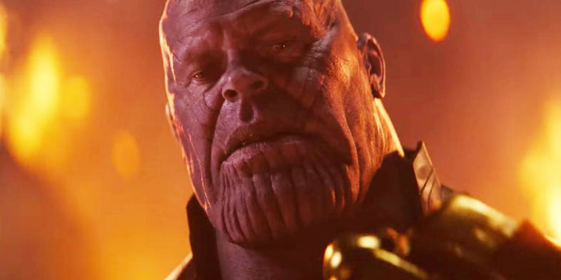
“I know what it's like to lose.”
INCORRECT!
You are

Slide 7
Question 1
What was Thanos’s end goal in Infinity war?
Remove 50% of the Universe
Create a new, better Universe
Become god of the Universe
Kill all of the Avengers forever

